Slide 1
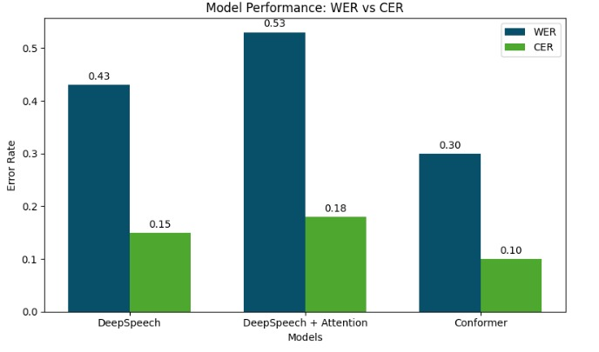
DeepSpeech++: Towards Improved ASR with Attention and Conformer
Human listeners naturally adapt to different voices and noisy environments—can machines do the same?
Problem Statement
🗣️
🔉
🧊
🧠
🔁
📝
Real World Applications
Popular end-to-end Automatic Speech Recognition (ASR) models like DeepSpeech often struggle with generalization in real-world, noisy, and speaker-diverse environments. In this project, we have focused on enhancing the DeepSpeech architecture by integrating attention mechanisms and Conformer blocks to improve alignment, adaptability, and transcription accuracy for diverse speech patterns using the LibriSpeech dataset.
🎧 Voice Assistants (Alexa, Siri, Google Assistant)
🧑‍🏫 Educational Tools & Captioning
📹 Video Captions
🌍 Multilingual Translation Services
📱 Voice Typing on Mobile Devices
DeepSpeech Model
DeepSpeech + Attention Model
Conformer Model
Input
Input
Input
Spectrogram
Spectrogram
Spectrogram
Conv 2D (1)
Conv 2D (1)
Conformer Block (16)
Model Details
FeedForward
Comparison with Existing Models
ResNet Blocks (3)
ResNet Blocks (3)
MHSA
Models Implemented:
DeepSpeech
DeepSpeech + Attention
Conformer
Hardware Setup: NVIDIA T100 GPU (Kaggle)
Dataset: Libri Speech Dataset (Audio data from audiobooks)
Train Data: 100 hours
Validation Data: 5.6 hours
Test Data: 5.6 hours
Convolution
Unlike DeepSpeech that uses basic RNNs, our Conformer model combines CNNs + Transformers and offers higher accuracy on LibriSpeech with less computational cost than the highest-performing models.
Attention mechanisms, a key building block of many SOTA models, did not improve our results, showing that sometimes less is more.
SOTA models like Wav2Vec2 and Whisper are built on gigantic datasets and millions of parameters, while our models are relatively lightweight.
While larger ASR models aspire for general-purpose use, our models focus on optimal, task-tailored learning to specialize to smaller or resource-constrained domains.
Bi-GRU (5)
Attention Block (12)
FeedForward
Linear Layer (2)
Linear Layer (2)
LayerNorm
Classifier
Classifier
Final LayerNorm
Hyperparameters
Reliable Transcript
Reliable Transcript
Reliable Transcript
Model | Batch Size | Epochs | Learning Rate
DeepSpeech | 8 | 10 | 0.0008
DeepSpeech + Attention | 16 | 25 | 0.0003
Conformer | 8 | 10 | 0.0005
Team:
Olan Pinto
Dnyaneshwari Rakshe

